Slide 1
EEE302 CONTROL LABORATORY
LECTURE 1
Research Assistant: Mehmet Uğur Soydemir
E-mail: soydemir_ugur@hotmail.com

Slide 2

What’s the MATLAB?
MATLAB® is the short for matrix laboratory. It is a numerical computing environment and a programming language which provides a suite of tools for computation, visualization, and more.
MATLAB is widely used in academic and research institutions as well as industrial enterprises.

Slide 3
WHY DO WE USE MATLAB ?
▸ It is a high-level language for technical calculation
▸ It offers a development environment for managing code, files and data
▸ It features interactive tools for exploration, design and iterative solving
▸ It supports mathematical functions for linear algebra, statistics, Fourier analysis,
filtering, optimization, and numerical integration
▸ It can produce high quality two-dimensional and three-dimensional graphics to aid data visualization
▸ It includes tools to create custom graphical user interfaces
▸ It can be integrated with external languages, such as C/C++, FORTRAN, Java,
COM, and Microsoft Excel

Slide 4
Competitors/Alternatives
• Julia, a high-level dynamic programming language aiming high-performance scientic computating (appeared in 2012)
• GNU Octave, an open-source clone of MATLAB
• computational languages/environments like S and R
• Excel
• Mathematica, Maple, Axiom, other CASes (Computer Algebra Systems)
• systems languages (C/C++, ...)
• general purpose languages (Java, Lisp, ...)
• scripting languages (Python/NumPy/SciPy, Perl, ...)
• MATLAB clones (Scilab, ...)

Slide 5
MATLAB Interface
The MATLAB desktop consists of the following panels.
Command Window Users are allowed to type MATLAB codes or basic unix commands into the command window. Press <return> to execute the command. Input command lines follow after a \>>" symbol, while printed results typically do not. For instance,
>> 1+3*2
ans =
7
>>

Slide 6
As another example, type pwd (the unix command \print working directory") to see current folder. Type clc command to clear commands displayed in the window.
Command History shows previous commands executed in the command window.
Current Folder shows the content of the current working directory.
Workspace shows the variables. After you type a = 1+1 in the command window, you see a appear in the workspace.
Editor MATLAB built-in editor, which can be called out by clicking \New Script" or pressing <ctrl>+N (or <cmd>+N). (You can use your own editor!)

Slide 7
M-files
MATLAB codes can be written in files known as the \m-files" having extension \.m". An m-file can either be a script m-file, a function m-file, or a class m-file. It is the first non-comment line of the code in a m-file that determines which kind (script, function or class) the m-file is.
Script m-file An m-file is by default a script m-file. A script m-file is literally a list of MATLAB commands. Suppose my_script.m is a script m-file saved in the current directory (that is, visible in the Current Folder window). Then one may type
>> my script
in the command window to execute the list of commands in my_script.m.

Slide 8
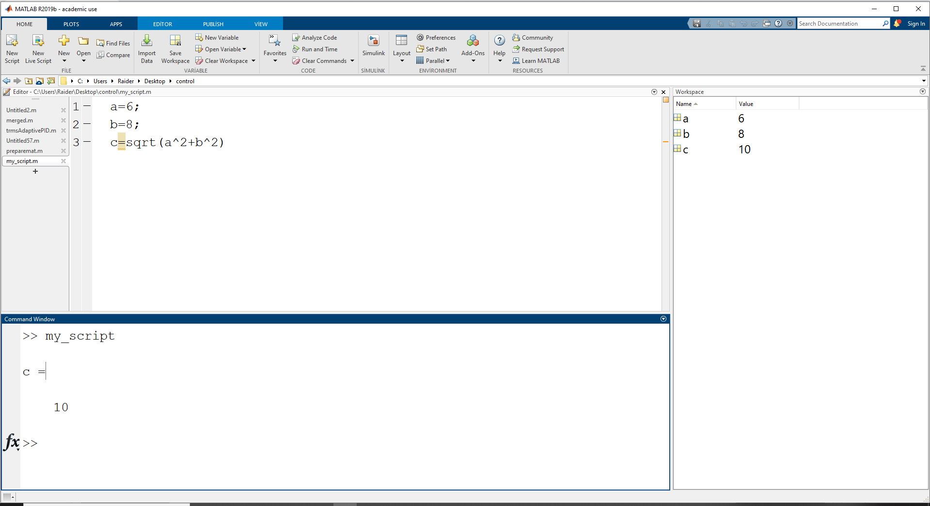
EXAMPLE: PYTHAGOREAN FORMULA
From the above example, you may have noticed that variables a, b and c appear in the workspace window. You may have also noticed what semicolons \;" do: a semicolon postfix suppresses MATLAB from printing the result of the command.
In the above example, sqrt( ) is a MATLAB built-in function (square-root function).

Slide 9
Function m-file
A function m-file is a file where one defines a function. The first (non-comment) line of a function m-file takes the form function
[output args] = my function( input args )
Importantly, the name of the function \my function" need to be the same as the filename of the m-file \my_function.m". Suppose my_function.m is a function m-file saved in the current folder, one may use this user- customized function \my function" in the command window or script m-files in the same folder.

Slide 10
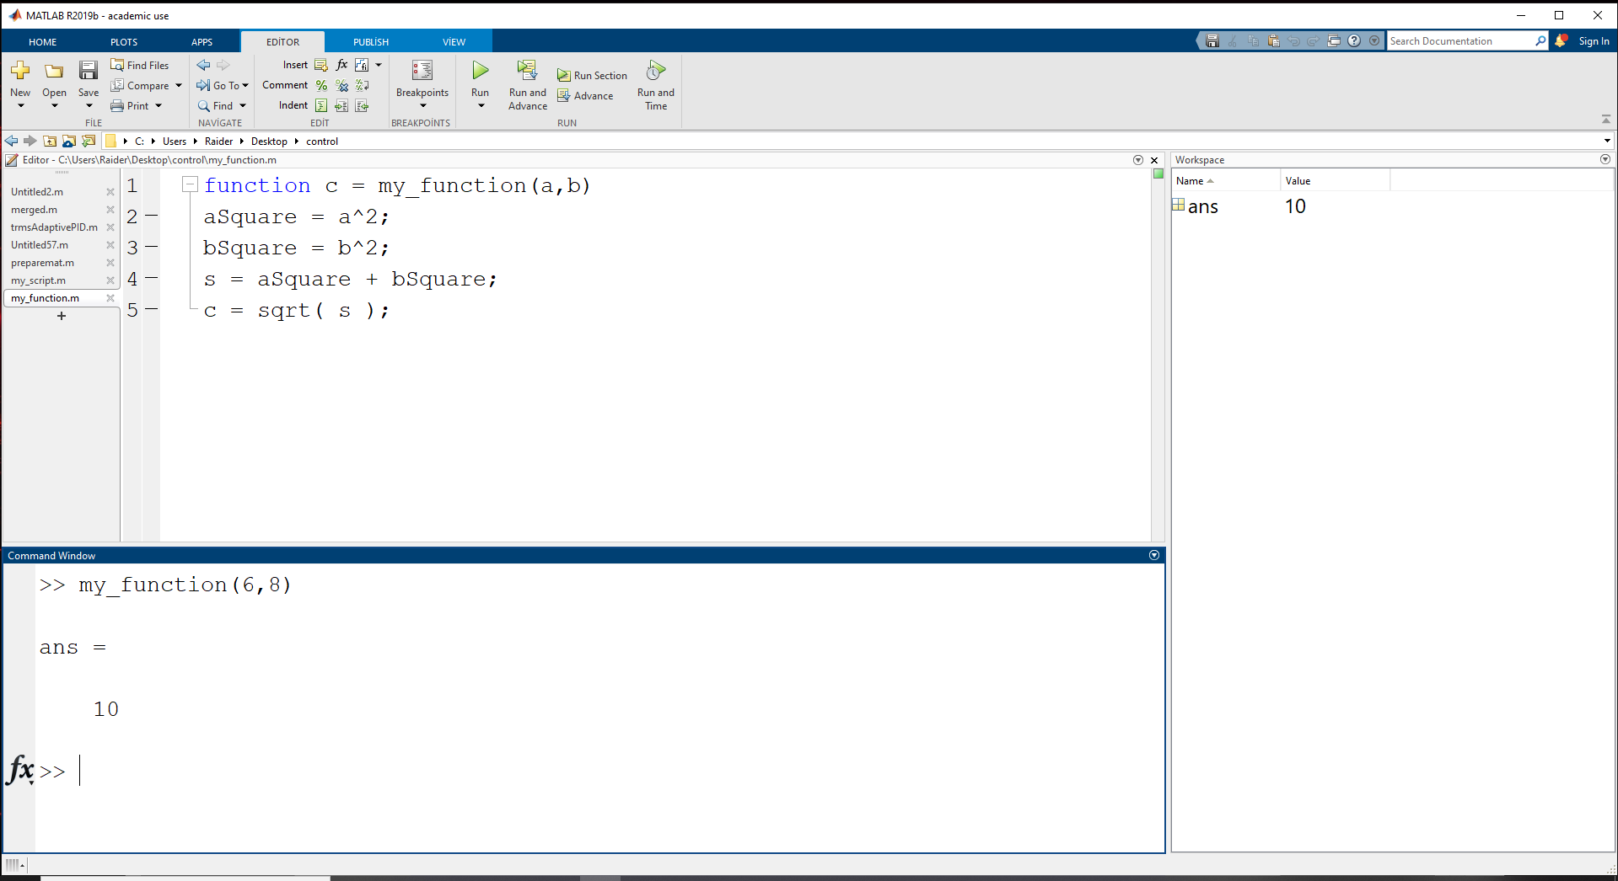
EXAMPLE: PYTHAGOREAN FORMULA
As one execute the command \d = my function( 3, 4)", MATLAB \dives into" the file my_function.m and runs the commands with a= 3 and b= 4. As MATLAB reaches the end of the file, having the calculated output value c= 5, MATLAB \jumps out of" the file and assign the value 5 to d. Notice that none of the variables a, b, aSquare, bSquare, s, c in the function m-file are rejected in the workspace. Variables in a function m-file are local variables. When MATLAB \dives into" or\jumps out of" a function, it only brings the values of the input arguments and output arguments with it. MATLAB function can have multiple output arguments.

Slide 11
Class m-file
The idea of class m-file is usually covered in a more advanced topic in MATLAB. It is just for the purpose of completing seeing all 3 types of m-file that we show class m-files in this chapter. It does not make sense to dig into details of involved concepts of object oriented programming before knowing the basic operations in MATLAB.

Slide 12
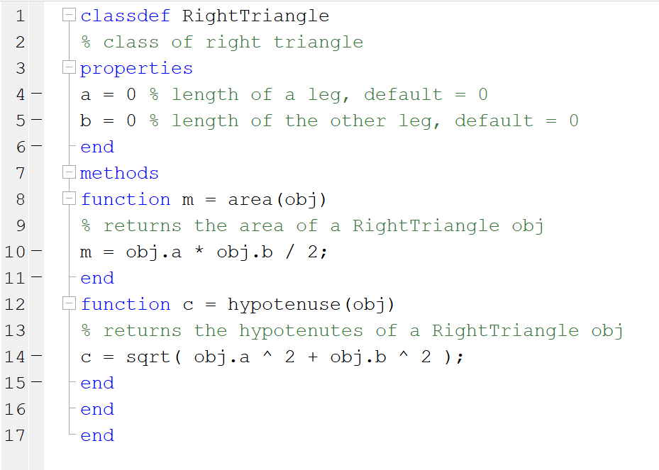

Slide 13
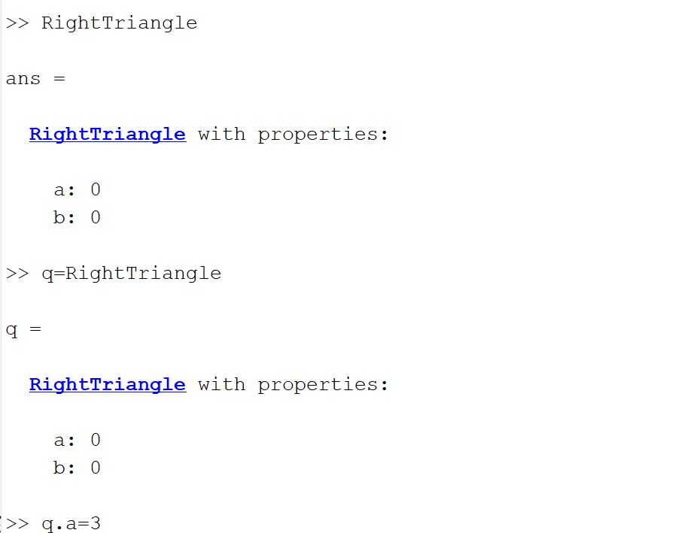

Slide 14
Comments in Code
You may have noticed that \%" in MATLAB code denotes that the rest of that line is a comment.
Another useful way of creating comments is the pair \%{, %}".
% This is a comment
%{
These lines
are
all comments
%}

